Slide 1

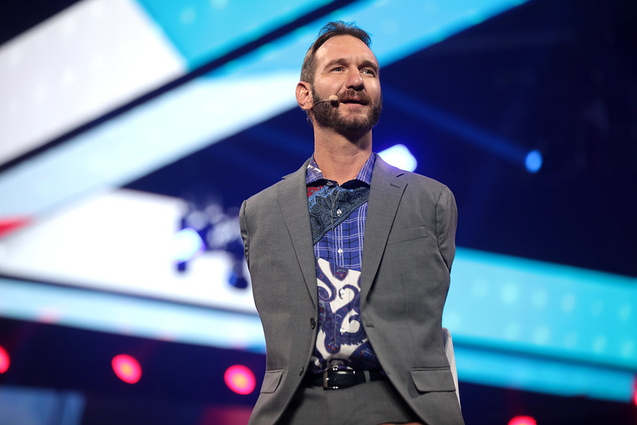


NICK VUJICIC
If you can't get a miracle, become one.

Slide 2
Our members
Mohomad Huzrin
Pujana Rathnayaka
20222269
20222362
Nuran Chandrasekara
Jithnuka Athurugiriya
20221926
20222123
Saad Mazhar
20221804

Slide 3
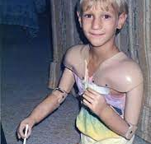
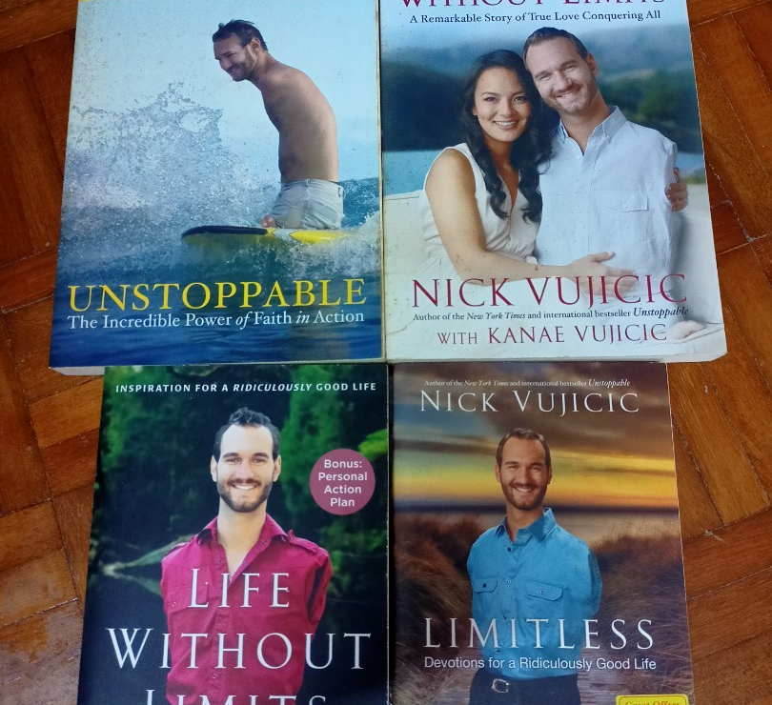

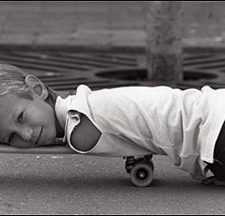

TABLE OF CONTENTS
Early life of Nick Vujicic
Present life of Nick Vujicic
Projects and Publications
Challenges
Conclusion

Slide 4
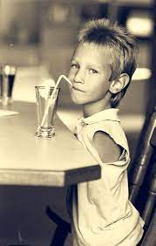
Early Life Of Nick Vujicic
Nick Vujicic was born on December 4, 1982, in Melbourne, Australia.
Nick was born with a rare condition known as phocomelia, which is characterized by the absence of limbs.
Family supported Nick with adaptations for easier life with disability.
Nick faced challenges in mainstream school, overcoming bullying and discrimination.

Slide 5
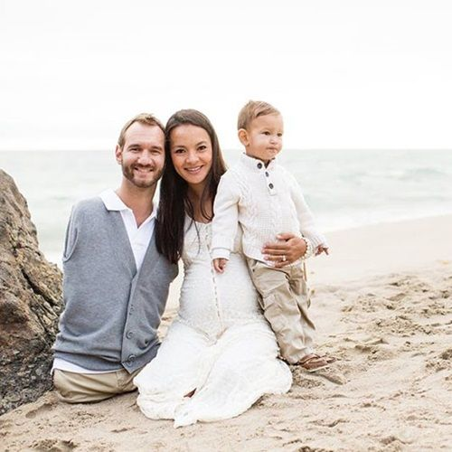
Present Life Of Nick Vujicic
Motivational Speaking,
Vujicic travels extensively around the globe, delivering inspiring speeches to audiences of all ages and backgrounds.
Writing,
Vujicic is a prolific author, having penned several books that have touched the lives of millions worldwide
Acting,
Vujicic has ventured into the world of acting, appearing in several short films and a few television shows.
Entrepreneurial Ventures,
Vujicic is not only a motivational speaker and author but also a successful entrepreneur.

Slide 6
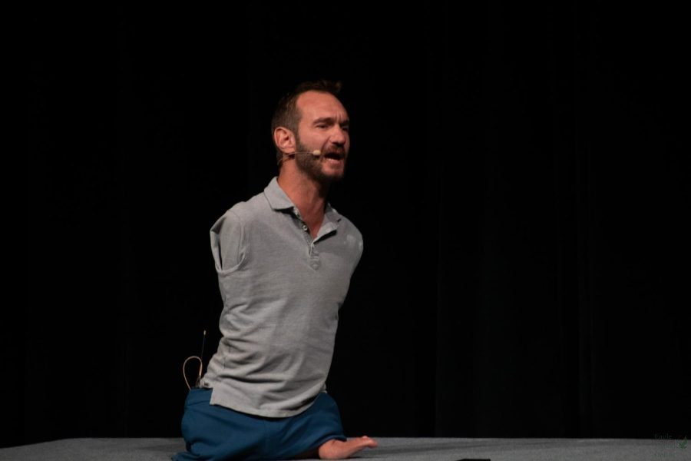
Projects
Life Without Limbs,
Founder and CEO
Mission: Sharing the message of hope, love, and faith globally
Attitude is Altitude ,
Founder
Goal: Motivating individuals to overcome challenges
Stand Strong USA ,
Involvement in the anti-bullying campaign
Focus on building resilience.

Slide 7
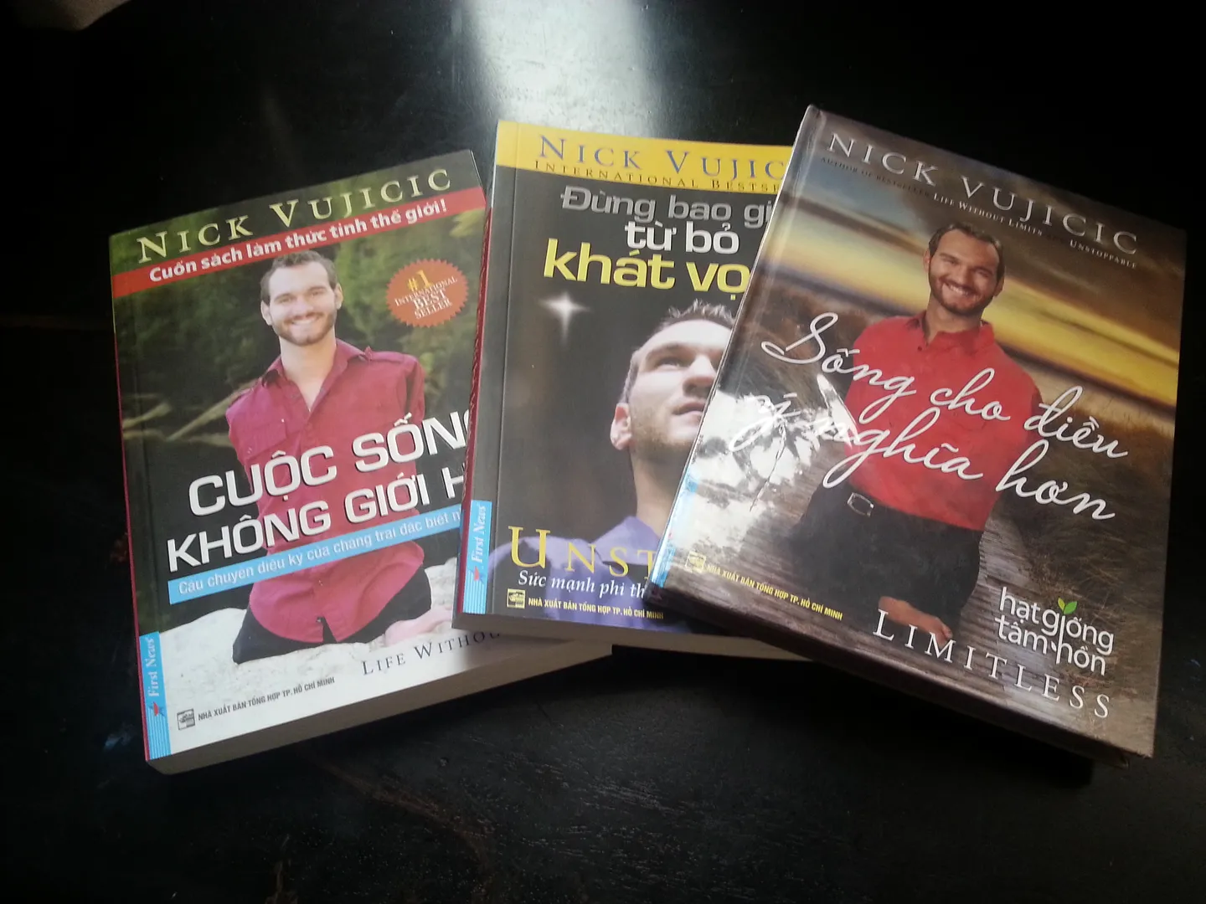
Publications
“Life without Limits (2010)”,
Nick’s first book sharing his story and principles
“Unstoppable (2012)”,
  Discussion on the role of faith in overcoming obstacles
“Love without Limits (2014)”,
  Co-authored with wife kanae Vujicic sharing their love story and challenges
“Be The Hands and Feet (2018)”,
  Encouraging readers to actively show love and compassion

Slide 8
Challenges
Physical limitations,
Born limbless, Nick Vujicic adapts with devices, showcasing resilience, inspiring others to overcome challenges with a positive mindset.
School harassment,
Nick Vujicic faced school harassment due to his physical differences. Overcoming adversity, he now advocates against bullying, promoting inclusivity.
Emotional Struggle,
Nick Vujicic, impacted by bullying and misconceptions, emphasizes emotional well-being, resilience, and a positive mindset for overcoming challenges.
Loneliness and suicide thoughts,
In adolescence, Nick Vujicic faced loneliness and suicidal thoughts, highlighting the vital role of mental health and resilience in his journey.

Slide 9
REFERENCE
Home (2023) Nick Vujicic. Available at: https://nickvujicic.com/ (Accessed: 14 November 2023).
Inspirational story of Nick Vujicic to warmly move you (2017) Author Voices. Available at: https://authorvoices.com/inspirational-writing/inspirational-story-nick-vujicic-warmly-move/ (Accessed: 15 November 2023).
Michael (2023) 11 inspiring facts about Nick Vujicic, Facts.net. Available at: https://facts.net/nick-vujicic-facts/ (Accessed: 14 November 2023).
Nick Vujicic (2023) Wikipedia. Available at: https://en.wikipedia.org/wiki/Nick_Vujicic (Accessed: 15 November 2023).

Slide 10
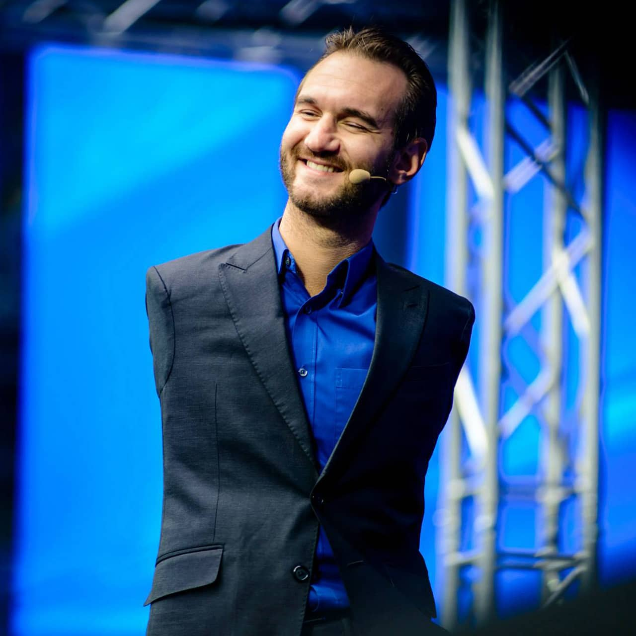
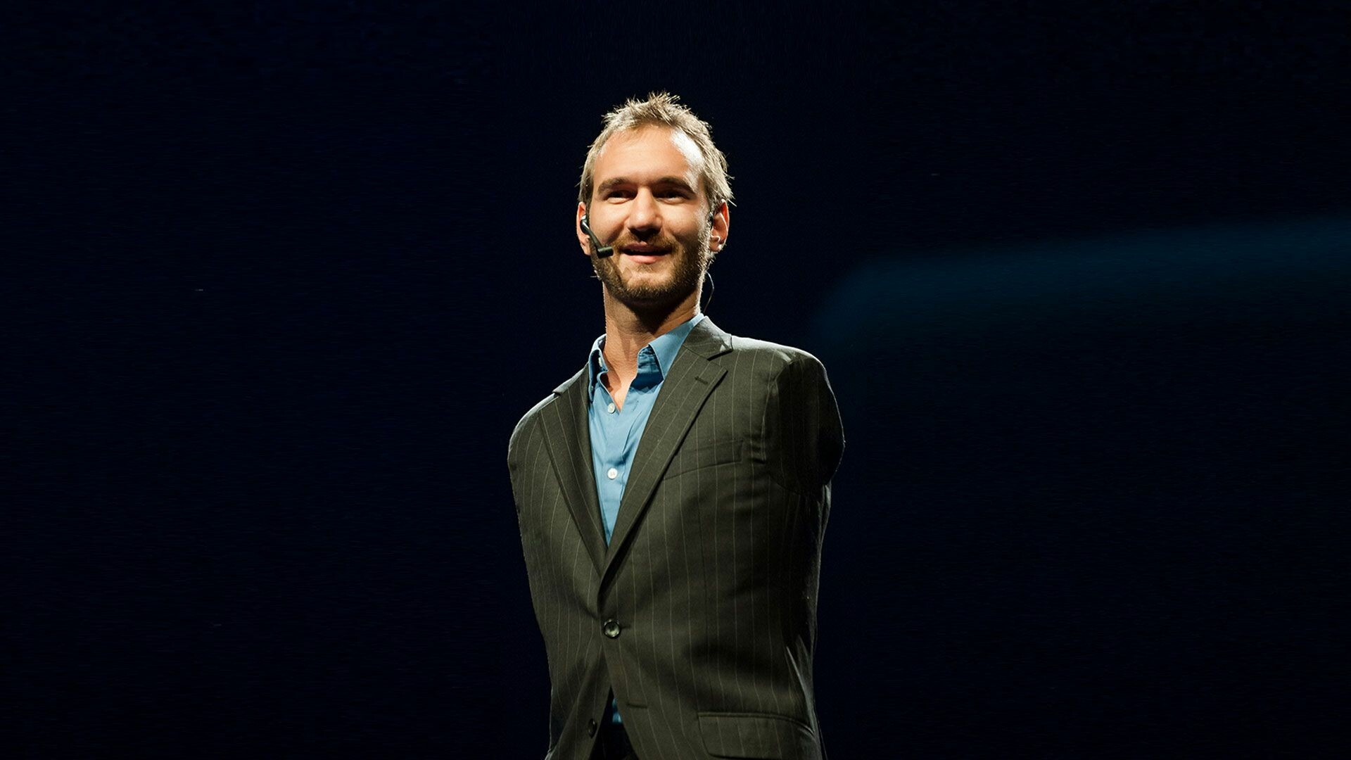
Conclution
Life without limbs

Slide 11
Q&A

Slide 12
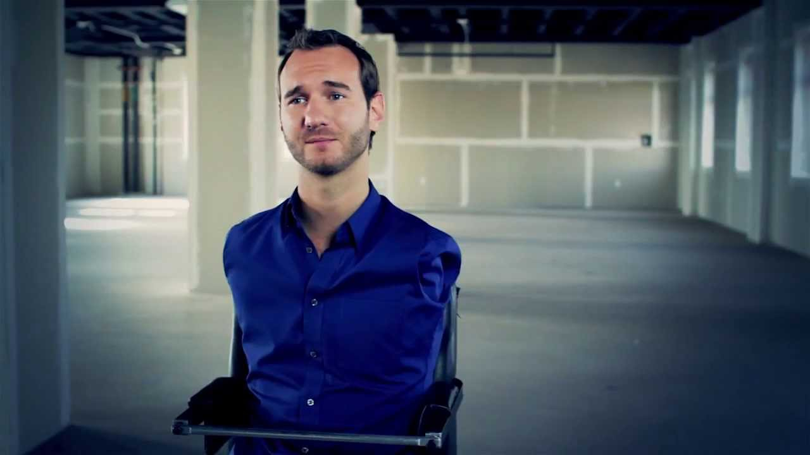
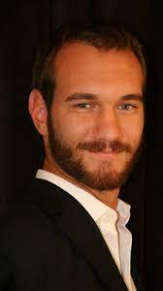
THANKS

